Slide 1

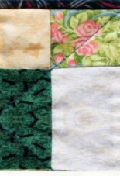
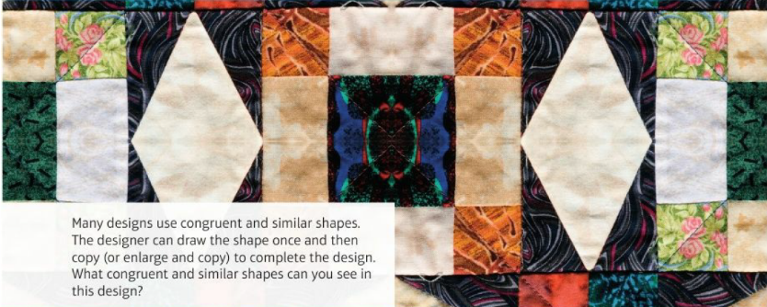
Mathematics (9-1) - iGCSE
2018-20
Year 09
Many designs use congruent and similar shapes. The designer can draw the shape once and then copy (or enlarge and copy) to complete the design. What congruent and similar shapes can you see in this design?
Unit 12 – Similarity and Congruence

Slide 2
Contents
Page iv
12 Similarity and congruence 363
Prior knowledge check 363
12.1 Congruence 364
12.2 Geometric proof and congruence 367
12.3 Similarity 370
12.4 More similarity 374
12.5 Similarity in 3D solids 378
Problem-solving 382
Check up 383
Strengthen 385
Extend 390
Knowledge check 394
Unit test 395

Slide 3
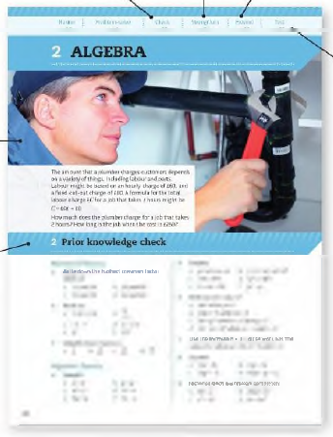
Contents
Page v
At the end of the Master lessons, take a check-up test to help you to decide whether to strengthen or Extend our learning
Extend helps you to apply the maths you know to some different situations
Unit Openers put the maths you are about to learn into a real-life context. Have a go at the question - it uses maths you have already learnt so you should be able to answer it at the start of the unit.
When you have finished the whole unit, a Unit test helps you see how much progress you are making.
Choose only the topics in strengthen thay you need a bit more practice with. You’ll find more hints here to lead you through specific questions. Then move on to Extend
Use the Prior knowledge check to make sure you are ready to start the main lessons in the unit. It checks your knowledge from Key Stage 3 and from earlier in the GCSE course. Your teacher has access to worksheets if you need to recap anything.

Slide 4
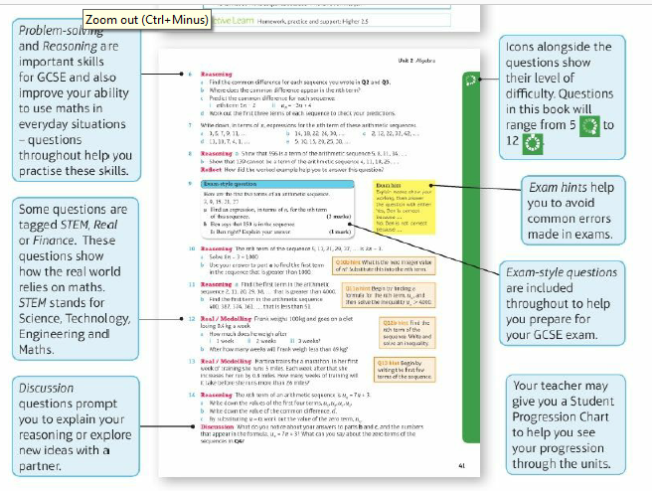
Contents
Page vi

Slide 5
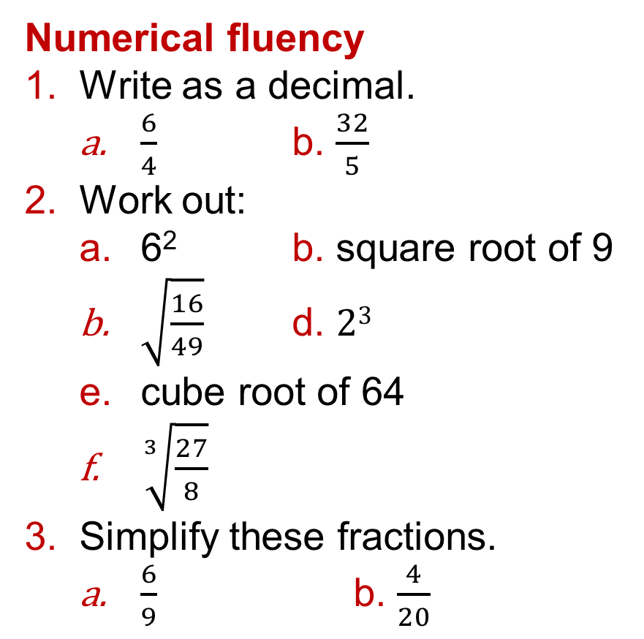
12 – Prior Knowledge Check
Page 363
Numerical fluency
Write as a decimal.
  $\frac{6}{4}$ b. $\frac{32}{5}$
Work out:
  6² b. square root of 9
  $\sqrt{\frac{16}{49}}$ d. $23$
  cube root of 64
  $\sqrt[3]{\frac{27}{8}}$
Simplify these fractions.
  $\frac{6}{9}$ b. $\frac{4}{20}$

Slide 6
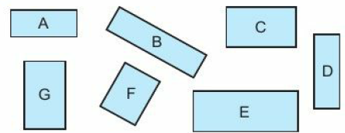
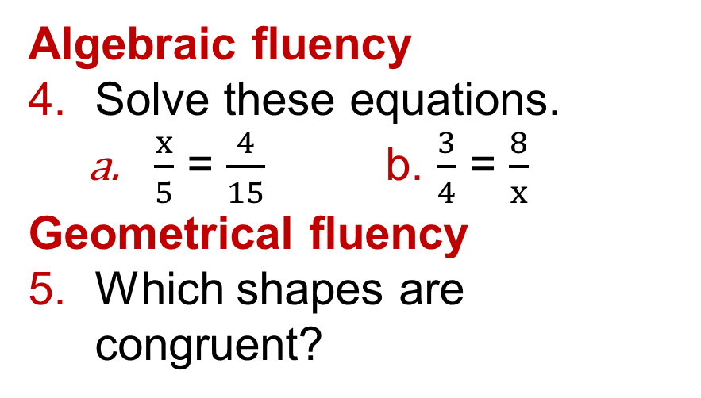
12 – Prior Knowledge Check
Page 363
Algebraic fluency
Solve these equations.
  $\frac{x}{5}$ = $\frac{4}{15}$ b. $\frac{3}{4}$ = $\frac{8}{x}$
Geometrical fluency
Which shapes are congruent?

Slide 7
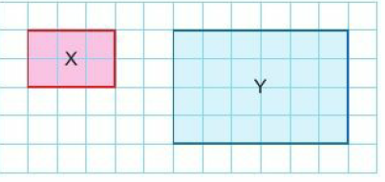
12 – Prior Knowledge Check
Page 363
What is the scale factor of the enlargement
  from shape X to shape Y
  from shape Y to shape X?

Slide 8
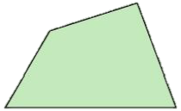
12 – Prior Knowledge Check
Page 363
This shape has perimeter 12 cm and area 5 cm².
It is enlarged by scale factor 2. Work out
  the perimeter of the enlarged shape
  the area of the enlarged shape.

Slide 9
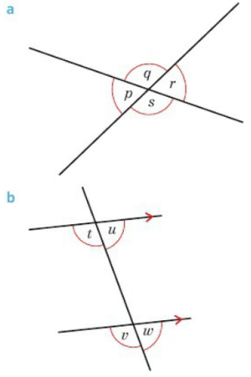
12 – Prior Knowledge Check
Page 364
Which angles are equal? Give reasons.

Slide 10
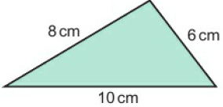
12 – Prior Knowledge Check
Page 364
Construct this triangle.
* Challenge
There are two possible triangles ABC where AB = 16cm, BC= 10cm and angle CAB = 40°. Construct them accurately.

Slide 11
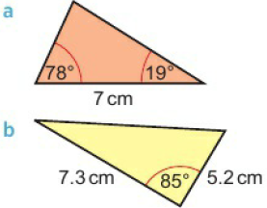
12 – Prior Knowledge Check
Page 364
Construct each triangle accurately.

Slide 12
12.1 – Congruence
Page 340
Objectives |  | Why Learn This?
Show that two triangles are congruent. Know the conditions of congruence. |  | All £1 coins are congruent. This means that coin machines can recognise their value.
Fluency
What do angles in a triangle sum to?
ActiveLearn - Homework, practice and support: Higher 12.1

Slide 13
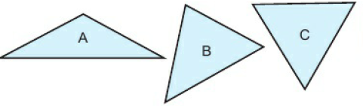
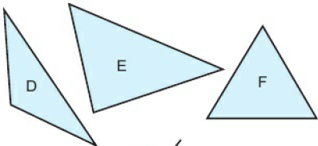
12.1 – Congruence
Page 364
Which triangles are congruent?
Warm Up

Slide 14
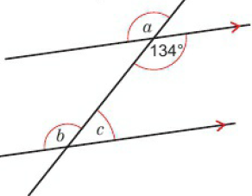
12.1 – Congruence
Page 364
Work out the sizes of angles a, b, and c. Give reasons for your answers.
Warm Up

Slide 15
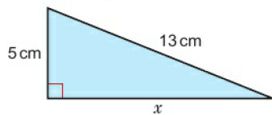
12.1 – Congruence
Page 364
Find the length of x.
Warm Up
Key Point 1
Congruent triangles have exactly the same size and shape. Their angles are the same and corresponding sides are the same length.
Questions in this unit are targeted at the steps indicated.

Slide 16
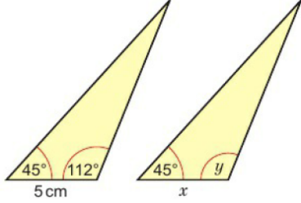

12.1 – Congruence
Page 365
Here is a pair of congruent triangles. Write down
  the size of angles
  the length of side x.
Key Point 2
Two triangles are congruent when one of these conditions of congruence is true. SSS (all three sides equal)
SAS (two sides and the included angle are equal)
AAS (two angles and a corresponding side are equal)
RHS (right angle, hypotenuse and one other side are equal)
Q4 hint - The angles by the 5 cm side will be the same in each triangle.

Slide 17

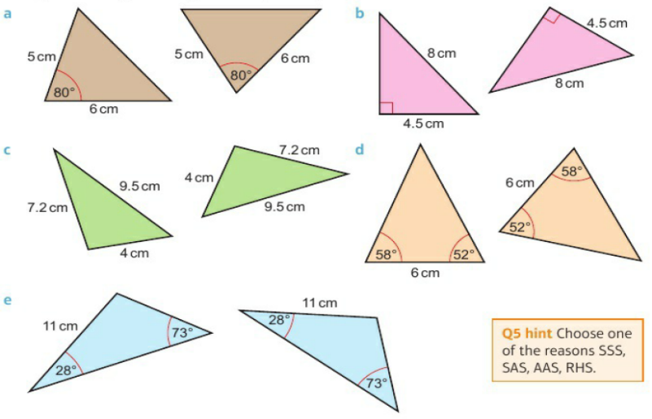
12.1 – Congruence
Page 365
Each pair of triangles is congruent. Explain why.

Slide 18

12.1 – Congruence
Page 366
State whether or not each pair of triangles described below is congruent. If the triangles are congruent, give the reason and write the corresponding vertices in pairs,
  ABC where AB = 7 cm, BC = 5 cm, angle B = 42°
  PQR where PQ = 50 mm, QR = 7 cm, angle Q = 42°
  ABC where AB = 7 cm, angle B = 42°, angle C = 109°
  PQR where PQ = 7 cm, angle Q = 109°, angle R = 42°
Q6 hint - Sketch each triangle. Angle A corresponds to □

Slide 19
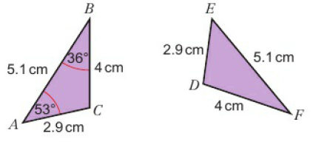
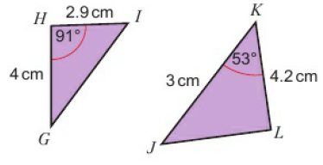
12.1 – Congruence
Page 366
Communication Which of these triangles are congruent to triangle ABC? Give reasons for your answers.

Slide 20
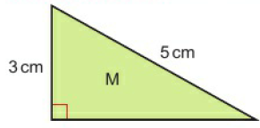
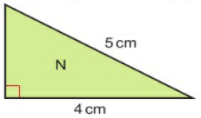
12.1 – Congruence
Page 366
Communication Are these triangles congruent? Justify your answer.
Communication Are all right-angled triangles with one side 5cm and one side 12cm congruent? Explain.
Q8 hint – Find the missing side.
Q9 strategy hint – Sketch some triangles

Slide 21

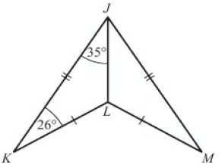
12.1 – Congruence
Page 366
11 – Exam-Style Questions
In this arrowhead,
angle JKL = 26° and
angle KJL = 35°.
Work out
angle JLK (1 mark)
angle JLM (1 mark)
angle LJM (1 mark)
Explain why triangles JKL and JLM are congruent. (2 marks)
Exam hint
Draw the two triangles separately and label each point.

Slide 22
12.2 – Geometric Proof & Congruence
Page 367
Objectives |  | Did You Know?
Prove shapes are congruent. Solve problems involving congruence. |  | A proof is a logical argument that shows something is true. Some mathematicians dedicate their lives to writing proofs.
Fluency
What are the conditions for congruence in triangles? How do you show sides and angles are equal on a shape?
ActiveLearn - Homework, practice and support: Higher 12.2

Slide 23
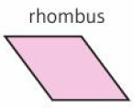
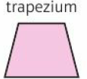
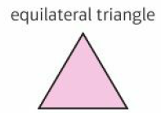
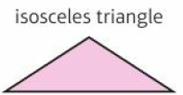
12.2 – Geometric Proof & Congruence
Page 367
Sketch each shape. Mark all the equal sides and angles.
Warm Up

Slide 24
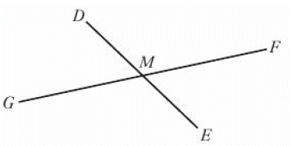
12.2 – Geometric Proof & Congruence
Page 367
M is the midpoint of DC. M is also the midpoint of FG.
  Which length is the same as DM?
  Which length is the same as GM?
  Which angle is the same as angle DMF?
Warm Up

Slide 25
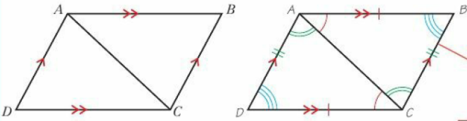
12.2 – Geometric Proof & Congruence
Page 367
Example 1
ABCD is a parallelogram. Prove triangle ABC is congruent to ADC.
Length AB= length CD because opposite
sides in a parallelogram are equal.
Length BC = length AD because opposite
sides in a parallelogram are equal.
Length AC is common to both triangles.
So triangle ABC is congruent to triangle ADC (SSS).
Mark all equal angles and sides.
State why AB = CD
State why BC = AD
State the condition used to prove congruence.

Slide 26

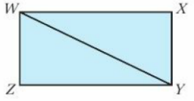
12.2 – Geometric Proof & Congruence
Page 367
Communication
WXYZ is a
rectangle.
  Prove that triangle WXY is congruent to triangle XYZ.
  Which angle is the same as angle XWY?
Q3 hint - Draw the triangles separately, showing equal sides and angles clearly. Give a reason for congruency.
Q3 communication hint - Write each statement of your proof on a new line. Give a reason for every statement you make.

Slide 27
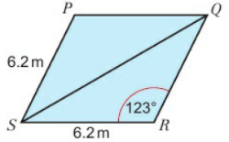
12.2 – Geometric Proof & Congruence
Page 368
Communication
The diagram
shows a rhombus
PQHS
  Prove that triangle PQS and triangle QRS are congruent,
  Find the size of
    angle QPS ii. angle RQS.
  Reflect Could you use the fact that the angles are the same in the two triangles to prove that they are congruent?
Q4 hint - What do you know about opposite sides in a rhombus?

Slide 28
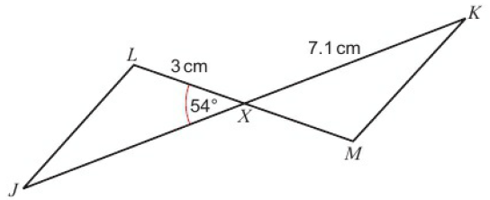
12.2 – Geometric Proof & Congruence
Page 368
Communication
In the diagram, X is the midpoint of JK. X is also the midpoint of LM. Prove that the triangles JLX and KMX are congruent.

Slide 29
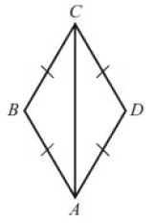
12.2 – Geometric Proof & Congruence
Page 368
6 – Exam-Style Questions
In the diagram. AB = BC = CD - AD
Prove that triangle ABC is congruent to triangle ACD.
(2 marks)
Exam hint
You need to write a series of logical statements that show the statement is true You must give a mathematical reason for each statement

Slide 30
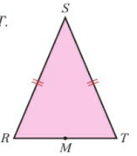
12.2 – Geometric Proof & Congruence
Page 368
Problem-solving / Communication FGH is an equilateral triangle. Point E lies on FH. EG is perpendicular to FH.
  Prove that triangle FGE is congruent to triangle GHE.
  Hence, prove that FE = ½FH.
Communication RST is an isosceles triangle such that RS = ST. M is the midpoint of line RT.
Use congruent triangles
to prove that the line
SM which cuts the
base of the triangle
at right angles also
bisects the base.
Q7 hint – Sketch the triangle
Q8 hint - Show that RM and MT are the same length.

Slide 31
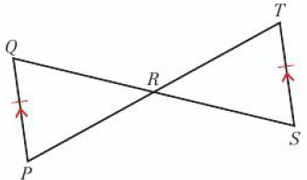
12.2 – Geometric Proof & Congruence
Page 369
Problem-solving / Communication Prove that triangles PQR and RST are congruent. Hence, prove that R is the midpoint of PT.
Q9 hint – Show that PR and RT are the same length.

Slide 32
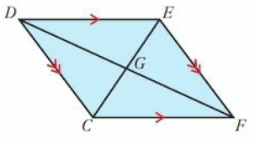
12.2 – Geometric Proof & Congruence
Page 369
Problem-solving
/ Communication
CDEF is a rhombus.
CD = DE = FF= CF.
CD is parallel to EF.
DE is parallel to CF.
Prove that
  triangles DEG and CFG are congruent
  triangles CDG and EFG are congruent
  G is the midpoint of both CF and DF and hence that the diagonals of a rhombus intersect at right angles.
Q10 hint – Make sure you only use known facts to justify your argument. Don't assume something if it has not been stated to be true.

Slide 33
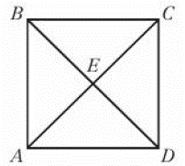
12.2 – Geometric Proof & Congruence
Page 369
Communication
ABCD is a square.
AC and BD are the
diagonals of the
square, which cross
at point F.
  Draw the square showing both diagonals,
  Mark on all equal angles,
  Which triangles are congruent in your diagram?
  What can you say about all the angles at point F?
  Using your answers to parts b-d, show that lines AC and BD bisect at point F, at right angles.

Slide 34
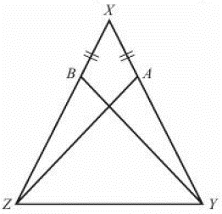
12.2 – Geometric Proof & Congruence
Page 369
13 – Exam-Style Questions
XYZ is an isosceles triangle with XY — XZ.
A and B are points on XY and XZ such that AX= BX.
Prove that triangle XAZ is congruent to triangle XBY. (2 marks)
Q13 strategy hint - Draw the two triangles separately and label each point. Look for a common angle or side.

Slide 35
12.3 – Similarity
Page 367
Objectives |  | Why Learn This?
Use the ratio of corresponding sides to work out scale factors. Find missing lengths on similar shapes. |  | We use similarity to draw floor plans to scale.
Fluency
What is the same and what is different in these two regular pentagons?
ActiveLearn - Homework, practice and support: Higher 12.3

Slide 36
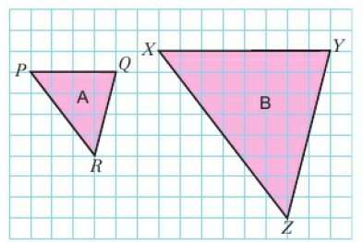
12.3 – Similarity
Page 370
What is the scale factor of the enlargement from
  A to B b. B to A.
Write the pairs of corresponding sides for triangles A and B in Q1.
Warm Up
Q2 hint - Corresponding sides map on to each other in an enlargement.

Slide 37
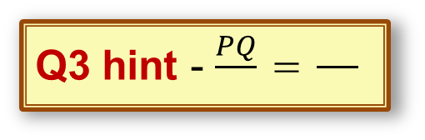
12.3 – Similarity
Page 370
a. Measure the angles and sides in the triangles in Q1.
  Write the ratios of corresponding sides as fractions.
  Discussion What do you notice about the angles? What do you notice about the ratios?
Q3 hint - $\frac{PQ}{□}$ = $\frac{□}{□}$
Key Point 3
Shapes are similar when one shape is an enlargement of the other. Corresponding angles are equal and corresponding sides are all in the same ratio.

Slide 38

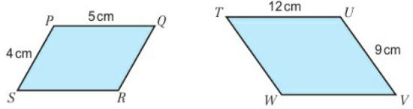
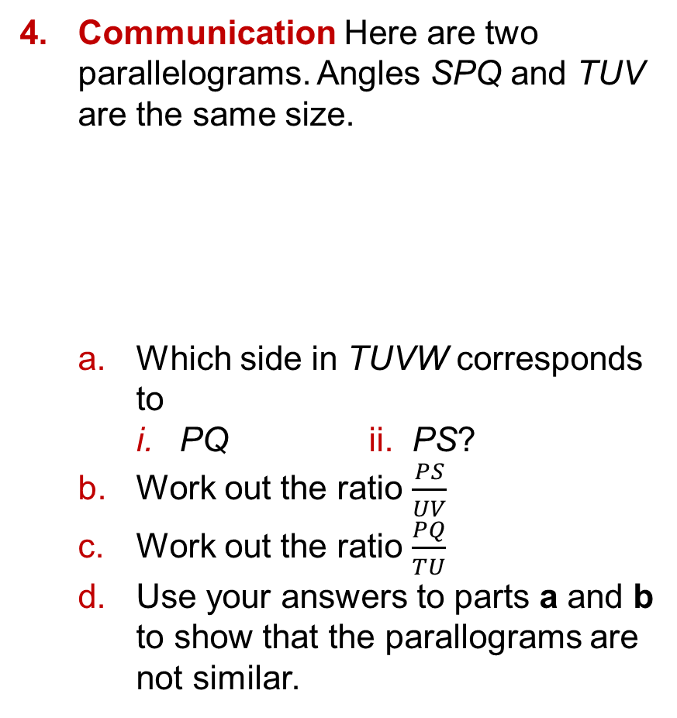
12.3 – Similarity
Page 370
Communication Here are two parallelograms. Angles SPQ and TUV are the same size.
  Which side in TUVW corresponds to
    PQ ii. PS?
  Work out the ratio $\frac{PS}{UV}$
  Work out the ratio $\frac{PQ}{TU}$
  Use your answers to parts a and b to show that the parallograms are not similar.

Slide 39

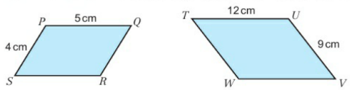
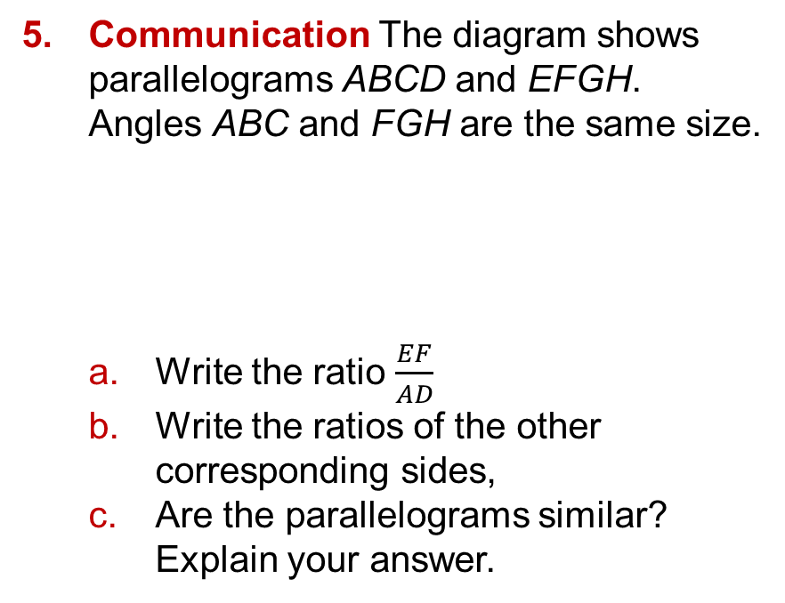
12.3 – Similarity
Page 371
Communication The diagram shows parallelograms ABCD and EFGH. Angles ABC and FGH are the same size.
  Write the ratio $\frac{EF}{AD}$
  Write the ratios of the other corresponding sides,
  Are the parallelograms similar?
  Explain your answer.
Q5 strategy hint - The shapes may not be in the same orientation. Make one ratio of the shorter sides and another ratio of the longer sides.

Slide 40
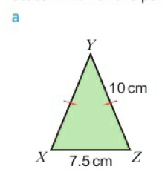
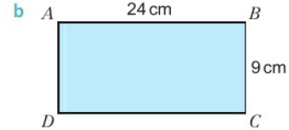
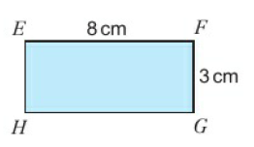
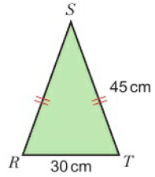
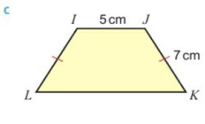
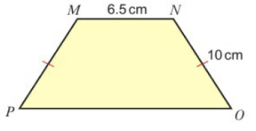
12.3 – Similarity
Page 371
State which of the pairs of shapes are similar.

Slide 41

12.3 – Similarity
Page 371
Show that pentagon ABCDE is similar to pentagon VWXYZ.
Discussion Are similar shapes congruent? Are congruent shapes similar?
Q7 hint - Show that the angles are the same.

Slide 42



12.3 – Similarity
Page 372
Example 2
These two rectangles
are similar. Find the
missing length x in
the smaller rectangle.
Ratio of lengths $\frac{x}{5}$
Ratio of widths $\frac{2}{4}$ = $\frac{1}{2}$
$\frac{small}{large}$ = $\frac{1}{2}$ = $\frac{x}{5}$
2x – 5
x = $\frac{5}{2}$ = 2.25cm
Write the ratio $\frac{4}{7}$ for the lengths and the widths.
Write an equation to solve x.

Slide 43

12.3 – Similarity
Page 372
These two rectangles are similar. Find the missing side length L in the larger rectangle.
Problem-solving / Real An aerial photograph shows a campsite with an outdoor swimming pool.
In the photograph, the pool measures 5cm by 2cm. The real pool is 25 m long. How wide is the pool?
Discussion How did you write your ratio? Does it matter which value is the numerator?

Slide 44


12.3 – Similarity
Page 372
a. Show that triangles A and B are similar.
  Work out length x in triangle B.
  Show that triangle C is similar to A and B. Explain.
  Write down the value of $\frac{opposite}{hypotenuse}$ for these triangles.
  What is another name for the ratio $\frac{opposite}{hypotenuse}$?

Slide 45


12.3 – Similarity
Page 372
Problem-solving / Real A small can of soup has a height of 10.5 cm and a diameter of 6cm.
A large can of soup is similar to the small can. It has a diameter of 8cm. Find the height of the large can of soup.
Problem-solving / Real The diagram shows one symmetrical panel in a tent. The sizes of the actual tent panel are shown on diagram B. The sizes of the plan are shown in diagram A.
  Work out the value of:
  x b. y
Q12 hint – Sketch the cans

Slide 46


12.3 – Similarity
Page 372
Communication Are the triangles in each pair similar? Explain.

Slide 47
12.3 – Similarity
Page 372
Here are two regular hexagons,
  Are they similar? Explain your answer,
  Are all regular hexagons similar?
Discussion Are all circles similar?
19 cm 10cm

Slide 48


12.3 – Similarity
Page 372
Triangle CDE is similar to triangle ∠FGH. ∠CDE= ∠FGH
Calculate the length of:
  FG b. FH
Reflect Write some notes to help you remember how to show that two shapes are similar.

Slide 49
12.4 – More Similarity
Page 374
Objectives |  | Why Learn This?
Use similar triangles to work out lengths in real life. Use the link between linear scale factor and area scale factor to solve problems. |  | You can work out the height of a skyscraper using similar triangles.
Fluency
A shape is enlarged by scale factor 3. What scale factor is its area enlarged by?
ActiveLearn - Homework, practice and support: Higher 12.4

Slide 50


12.4 – More Similarity
Page 374
What is the scale factor of the enlargement that maps
  triangle Y onto triangle Z
  triangle Z onto triangle Y.
Warm Up

Slide 51

12.4 – More Similarity
Page 374
Communication Are triangles ABE and CDE similar.
Q2 hint – Find the angles in triangle AEB. Give reasons for your answers.

Slide 52

12.4 – More Similarity
Page 375
a. Show that triangles PQR and RST are similar.
  Find the missing length x.
Q3b hint – Mark equal angles.

Slide 53


12.4 – More Similarity
Page 375
Communication
  Explain why triangles FGH and FJK are similar.
  b Calculate the length HK.
  Calculate the length JK
Q4a hint –
Draw
the triangles
separately.

Slide 54

12.4 – More Similarity
Page 375
Communication
  Find the sizes of angle PQN and angle LMN.
  Explain why triangle LMN is similar to triangle LPQ.
  Find the length of LQ.
  Find the length of NQ.
  Find the length of MP

Slide 55


12.4 – More Similarity
Page 375
Real Calculate the height of The Shard using similar triangles.
Shape K is similar to shape L. The perimeter of shape K is 7.5cm and its area is
4.8cm². Find
the perimeter
and area of
shape L.

Slide 56

12.4 – More Similarity
Page 376
The diagram shows two flower beds made in the shape of similar trapezi;
The perimeter of the small flower bed is 36 m.
The area of the small flower bed is 60 m². Work out the perimeter and area of the large flower bed.
Q7 strategy hint - First work out the linear scale factor of the enlargement (k). The area is enlarged by scale factor □

Slide 57

12.4 – More Similarity
Page 376
8 – Exam-Style Questions
A company
makes teddy
bears.
The company
makes small
bears that are
15 cm tall. A
small bear has
a surface area of 200 cm².
The same company make giant bears which are 1.8 m tall. A giant bear is mathematically similar to a small bear.
Work out the surface area of a giant bear. (3 marks)
Q8 strategy hint - First work out the length ratio. Remember the lengths need to be in the same units.

Slide 58


12.4 – More Similarity
Page 377
Example 2
Shape D is similar to shape E. Calculate the length of shape E.
Area scale factor = $\frac{539}{11}$ = 49 = k²
k = $\sqrt{49}$ = 7
Shape E has length 7 x 4 = 28cm
In an enlargement by scale factor k, the area is enlarged by scale factor k².
K is the linear scale factor.

Slide 59


12.4 – More Similarity
Page 377
Shape A is similar to shape B.
The area of shape A is 126cm².
The area of shape B is 283.5 cm². Calculate:
  length x b. length y.
Two similar triangles have areas of 36cm² and 100cm² respectively. The base of the smaller triangle is 3 cm.
Find the length of the base of the larger triangle.

Slide 60

12.4 – More Similarity
Page 377
A postage stamp has a
surface area of 6cm².
What is the area of a
similar stamp with
lengths that are
  twice the corresponding
  lengths of the first stamp
  three times the corresponding lengths of the first stamp?
Problem-solving The fronts of two cereal packets are similar. The area of front of the larger packet is 1035 cm² and the area of the front of the smaller one is 460cm².
The height of the larger packet is 45 cm. Work out the height of the smaller packet.

Slide 61
12.4 – More Similarity
Page 377
A triangle has sides of A, 5 and 6.4cm. Its area is 10cm².
How long are the sides of a similar triangle that has an area of 90cm²?
Problem-solving A sheet of A2 paper and a sheet of A4 paper are similar.
The area of a sheet of A2 paper is 2500 cm² and the area of a sheet of A4 paper is 625 cm². The width of a sheet of A2 paper is 42 cm.
  Work out the area scale factor,
  Work out the length scale factor.
  Use the length scale factor to work out the width of a sheet of A4 paper.
Reflect Why are volume scale factors important when going from making a scale model to making the real object?

Slide 62

12.5 – Similarity in 3D Models
Page 378
Objectives |  | Why Learn This?
Use the links between scale factors for length, area and volume to solve problems. |  | A scale model is similar to the original. Architects use 3D scale models of big projects to give their clients a better understanding of the way a new building will fit into its surroundings.
Fluency
Work out the volume and surface area of this cube.
ActiveLearn - Homework, practice and support: Higher 12.5

Slide 63


12.5 – Similarity in 3D Models
Page 378
Work out
  the cube root of 125
  $\sqrt[3]{\begin{aligned}64 \\ 27\end{aligned}}$
Convert 1.5 litres to cm³
Prisms A and B are similar.
The volume of prism A is 12 cm³. Calculate the volume of prism B.
Warm Up

Slide 64

12.5 – Similarity in 3D Models
Page 378
In each pair of diagrams, solid A is enlarged to make
solid B. Copy and complete the table.
Discussion What do you notice about the scale factors of volume?
Linear scale factor | Volume A | Volume B | Volume Scale Factor
Key Point 4
When a shape is enlarged by linear scale factor k, the volume of the shape is enlarged by scale factor k².

Slide 65



12.5 – Similarity in 3D Models
Page 379
Tetrahedrons C and D are similar.
The volume of tetrahedron C is 15cm³. Calculate the volume of tetrahedron D.
Cones E and F are similar.
The volume of cone E Is 202.5 cm³. Calculate the volume of cone F.

Slide 66


12.5 – Similarity in 3D Models
Page 379
3
Example 2
Cylinders G and H are similar.
The diamond of G is 6cm.
The volume of G is 108cm³.
The volume of H is 256cm³.
Work out the diameter of d of
cylinder H
Volume scale factor = $\frac{large}{small}$ = $\frac{256}{108}$ = $\frac{64}{27}$ = k²
k =$\sqrt[3]{\frac{64}{27} }$ = $\frac{\sqrt[3]{64} }{\sqrt[3]{27} }$ = $\frac{4}{3}$
d = $\frac{4}{3}$ x 6 = 8cm
In an enlargement by scale factor k, the volume is enlarged by scale factor k³.

Slide 67

12.5 – Similarity in 3D Models
Page 379
Sphere J is similar to sphere K. The volume of J is 27 times the volume of K. Work out the diameter of sphere K.

Slide 68

12.5 – Similarity in 3D Models
Page 380
Prisms Land M are similar.
The volume of prism M is 343 times the volume of prism L. Calculate the value of
  length x
  length y.
Key Point 5
When the linear scale factor is k:
Lengths are multiplied by k
Area is multiplied by k²
Volume is multiplied by k³

Slide 69

12.5 – Similarity in 3D Models
Page 380
Reasoning Pyramid A and pyramid Z are similar.
The volume of pyramid A is 125 times the volume of the volume of pyramid Z. The surface area of pyramid Z is 60 cm².
  Write down the volume scale factor, k³.
  Work out the linear scale factor, k.
  Work out the area scale factor, k².
  Calculate the surface area of pyramid A.

Slide 70

12.5 – Similarity in 3D Models
Page 380
For Q10-15, give your answers correct to 3 significant figures.
Problem-solving Cylinders B and C are mathematically similar.
The volume of B is $\frac{1}{64}$ of the volume of C. The surface area of B is 35.2 cm².
Work out the surface area of cylinder C.
Problem-solving / Real A commercial sink has a surface area of 6300 cm² and capacity of 12.75 litres.
Find the surface area of a similar sink which has a capacity of 7 litres.
Q10 Hint - Find the linear scale factor first.

Slide 71

12.5 – Similarity in 3D Models
Page 381
12 – Exam-Style Questions
The bases of two similar cones, A and B, are 207 cm² and 92 cm² respectively.
The volume of cone A is 837 cm³.
Show that the volume of cone B is 248 cm³. (5 marks)
Exam hint - Find the linear scale factor first

Slide 72

12.5 – Similarity in 3D Models
Page 381
13 – Exam-Style Questions
The diagram shows two similar solids, A and B.
Solid A has a volume of 80 cm³,
Work out the volume of solid B. (2mk)
Solid B has a total surface area of 160cm
Work out the total surface area of solid A. (2 marks)
Nov 2012, Q25, 1MA0/1H

Slide 73
12.5 – Similarity in 3D Models
Page 381
Real / Reasoning A can of paint is 18cm tall and holds 2.5 litres of paint. A similar can is 1.5 times as tall.
How much paint does it hold?
Reasoning / Communication
Explain why any two cubes are similar.
Explain why two cuboids are not necessarily similar.
Q15 strategy hint - Sketch some cubes and cuboids.

Slide 74

12 – Problem Solving
Page 382
Objectives | Use geometric sketching to help you solve problems.
Label the origin on a grid, 0. Then d raw these line segments:
  y = 4 from x = 0 to x = 3. Label it PQ.
  y = 2 from x = 0 to x = 1.5. Label it ST.
  y = $\frac{4}{3}$x from x = 0 to x = 3.
  Show that triangles OPQ and OST are similar.
Q1 hint - Sketch the line segments. Use the example to help you show that the resulting triangles are similar.

Slide 75


12 – Problem Solving
Page 382
3
Example 2
The vertices of triangle ABC are at (0.5, 0), (3.5,0) and (3.5,4). The vertices of triangle DBF are at (-2,-2), (5.5,-2) and (5.5,8 Show that the two triangles are similar.
Shapes are similar if corresponding sides are in the same ratio. Corresponding sides: AB and DE; BC and EE, AC and DF
AB = 3 BC= 4 AC² = 32 + 42 = 25
(Pythagoras' theorem),
So AC= $\sqrt{25}$ = 5
DE = 7.5 EF= 10 DF² = 7.5² + 10² = 156.25
(Pythagoras' theorem),
so DF= $\sqrt{\text{1}\text{56}\text{.}\text{25}}$ = 12.5
$\frac{AB}{DE}$ = $\frac{3}{7,5}$ = 0.4 $\frac{BC}{EF}$ = $\frac{4}{10}$ = 0.4 $\frac{AC}{DF}$ = $\frac{5}{12.5}$ = 0.4
All corresponding sides are in the same ratio.
Therefore, triangles ABC and DEF are similar.
State how you can show two triangles are similar
Sketch the triangles
Use your sketch to identify the corresponding sides in the two triangles.
Find the lengths of corresponding sides. ABC and DEF are right-angled triangles. You can use Pythagoras' theorem to find the lengths of hypotenuses AC and DF.
Find the ratios of corresponding sides.
Confirm you have shown the triangles are similar.

Slide 76
12 – Problem Solving
Page 382
A surveyor estimates the height of a tree. He walks 50 paces in a straight line from the bottom of the tree, and puts a 1.2 m pole vertically in the ground.
Then he walks another 10 paces on the same straight line.
Now when he looks from ground level, the top of the pole and the top of the tree are exactly in line.
How tall is the tree?
Q2 hint - Sketch a diagram. Use similar triangles to work out the height of the tree.

Slide 77
12 – Problem Solving
Page 383
A circular water well has diameter 75cm. It is surrounded by wooden decking of uniform width.
The area of the wooden decking is 5.5 m². What width is the decking?
Show that a triangle with one interior angle of 84° and two exterior angles of 132° is isosceles.
Q3 hint - Sketch a diagram.
Q3 communication hint - 'Uniform width' means the width of the decking is the same all the way around the well.
Q5 hint - Sketch a diagram. How can you show that a triangle is isosceles?

Slide 78
12 – Problem Solving
Page 383
A parallelogram ABCD has sides 8 cm and 15cm. The angles in one pair of angles are twice the size of the angles in the other pair.
The diagonal, AC, joins the bigger angles,
  What is the size of angle ABD
  Prove that triangles ABC and ACD are congruent.
Q4a hint – Sketch a diagram. Label all angles in terms of x.
Q4b hint - Use the diagram you sketched for part a and the conditions for congruence.

Slide 79
12 – Problem Solving
Page 383
A builder has an 8 m ladder. He needs to reach a gutter that is 7.8 m high.
The building site safety rules state that all workers must obey the 4 in 1 ladder rule (for every 4 m in vertical height, the base of the ladder must be 1 m away from the base of the wall).
Show that the builder cannot use his ladder.
Reflect How did geometric
sketching help you to solve these problems? For which problems
did it help the most? Why?
Reflect

Slide 80

12 – Check Up
Page 383
12. Check up | Log how you did on your Student Progression Chart
Congruence
Which of these triangles are congruent? Give reasons for
your answer.

Slide 81

12 – Check Up
Page 383
HJKL is a rectangle.
  Prove that triangle HJK and triangle HKL are congruent. Explain your answer fully.
  Using a different condition for congruence, prove that triangles HJK and HKL are congruent.

Slide 82


12 – Check Up
Page 383
Similarity in 2D shapes
Show that each pair of shapes is similar.

Slide 83

12 – Check Up
Page 384
Quadrilaterals ABCD and EFGH are similar.
Work out
  length AD b. length GH.

Slide 84

12 – Check Up
Page 384
Communication
  Prove that triangle ABE is similar to triangle ACD.
  Work out length CD.

Slide 85

12 – Check Up
Page 384
a. Show that PQR and RST are similar triangles.
  Work out the missing lengths in the diagram, x and y.

Slide 86

12 – Check Up
Page 384
Shapes D and E are similar. Shape D has a perimeter of 41.4 cm and an area of 112.5 cm².
Calculate the area and perimeter of shape E.

Slide 87

12 – Check Up
Page 385
Problem-solving Two whole cheeses are mathematically similar in shape. The smaller cheese has a radius of 8.4cm and a volume of 665cm³.
The larger cheese has a radius of 13.2cm.
Work out the
volume of
the larger
cheese.

Slide 88
12 – Check Up
Page 385
Problem-solving Pyramids A and B are similar.
The surface area of pyramid A is 1260 cm².
The surface area of pyramid B is 180cm².
The volume of pyramid A is 9604 cm³.
Work out the volume of pyramid B.
How sure are you of your answers? Were you mostly:
Just guessing ☹
Feeling doubtful 😐
Confident ☺
What next? Use your results to
decide whether to strengthen or
extend your learning.
Reflect

Slide 89
12 – Check Up
Page 385
* Challenge
Draw three different right-angled triangles, each with an angle of 45°.
Are they all similar? Explain.
On a calculator, work out the tangent of the 45° angle for each triangle.
What do you notice?
Draw three more right-angled triangles, each with an angle of 60°.
Are they all similar? Explain.
On a calculator, workout the cosine of the 60° angle for each triangle.
What do you notice?

Slide 90

12 – Strengthen
Page 385
12. Strengthen
Congruence
Reasoning Which of these triangles is not congruent to triangle A?
Q1 hint - If you rotated triangles B, C and D, which one would not fit exactly on A?

Slide 91




12 – Strengthen
Page 386
Which of these triangles are congruent?
Q2 hint – Sketch the triangles and find any missing angles.

Slide 92

12 – Strengthen
Page 386
Draw two right-angled congruent triangles on paper and cut them out.
What shapes can you make by putting these two triangles together?
You must place the triangles with equal sides touching.
Q3 hint – Make sure that sides meet exactly when you match up the triangles.

Slide 93


12 – Strengthen
Page 386
Communication Why are these pairs of triangles congruent?
Q3 h4int – Choose from these conditions of congruence, AAS, SAS, SSS, RHS

Slide 94

12 – Strengthen
Page 386
Problem Solving / Communication KLMN is a kite.
  Explain why triangles KLM and KNM are congruent,
  Explain why triangles KLN and MLN are not congruent.
Q5 hint - Do the triangles fit exactly on to each other?

Slide 95

12 – Strengthen
Page 387
Similarity in ZD shapes
For each pair of similar triangles:
  name the three pairs of corresponding sides
  state which pairs of angles are equal.
Q1 hint - Draw each pair of triangles facing the same way.

Slide 96




12 – Strengthen
Page 387
Triangles C and D are similar.
  Copy and complete the table showing the pairs of corresponding sides.
  Use the scale
  factor to work
  out x and y.
C | D | $$\frac{C}{D}$$
3
5
y
$$\frac{□}{□}$$
Q2 hint - $\frac{5}{x}$ =

Slide 97


12 – Strengthen
Page 387
Reasoning Find the missing length x in these similar shapes.
Q3 strategy hint – Draw a table for G and H like the one in Q2.
Reasoning All these shapes are similar. Work out the lengths marked
with letters.
Q4 strategy hint – Sketch the triangles the same way up.

Slide 98

12 – Strengthen
Page 388
Which of these triangles are similar to triangle A?

Slide 99

12 – Strengthen
Page 388
Reasoning / Communication
The diagram shows two triangles,
  Explain why
    a = f ii. b = e iii. c = d.
  When three pairs of angles are equal, what does this tell you about the two triangles?
  Trace each angle and compare it with its paired angle,
  Find the
  missing
  lengths.

Slide 100

12 – Strengthen
Page 388
a. Sketch the diagram. Mark all the angles that are the same.
  Prove that triangles ABC and ADE are similar.
  Trace the small and the large triangle. Sketch them beside each other. Label the lengths of the sides you know,
  Work out the scale factor and missing lengths.
Q7b hint - Show the triangles have the same angles. For example, angle ACB = angle □. Give reasons for your answers.
Q7a hint - Use the parallel lines to find equal angles.

Slide 101
12 – Strengthen
Page 389
a. Draw a rectangle 2 by 5 on squared paper. Label it A.
  Draw an enlargement of A with scale factor 2. Label it B.
  Work out the perimeter of A and the perimeter of B.
  Copy and complete these statements: lengths on A: lengths on B, scale factor is 2. perimeter of A: perimeter of B, scale factor is Q.
  Enlarge A by scale factor 3. Label it C.
  Predict the perimeter of C.
  Now work out the perimeter to check your prediction.

Slide 102


12 – Strengthen
Page 389
Triangle A is similar to triangle B.
  Work out the scale factor of A to B by comparing the given side lengths.
  The perimeter of triangle A is 12cm. b What is the perimeter of triangle B?

Slide 103
12 – Strengthen
Page 389
Draw a 1 cm by 3 cm rectangle on squared paper. Label it A
Draw an enlargement of A with scale factor 2. Label the new shape B. How many times will A fit into B?
Copy and complete
lengths on A: lengths on B, scale factor is 2
area of A: area of R, scale factor is □ = □^{2.}
The area of triangle A in Q9 is 6cm². What is the area of triangle B?

Slide 104


12 – Strengthen
Page 389
Similarity in 3D solids
The diagram shows two cubes, with side length 1 cm and side length 2cm.
  How many times does A fit into B?
  Copy and complete
  lengths on A: lengths
  on B, scale factor is 2
  volume of A: volume
  of B, scale factor is □ = 2□
  Cube A is enlarged to make cube C, so the side length is now 3 cm.
  What is the scale factor of the lengths for this enlargement?
  Predict: volume of A: volume of C, scale factor is □ = □□
  Draw a sketch to check your prediction.

Slide 105


12 – Strengthen
Page 389
Cuboid X and cuboid Y are similar.
Base area = 8cm² Base area = 72cm²
The area of the base of cuboid X is 8 cm².
The area of the base of cuboid Y is 72 cm²,
  Work out the area scale factor to change X to Y.
  Find the linear scale factor,
  Find the volume scale factor.
  The volume of cuboid X is 12.5cm³.
  Find the volume of cuboid Y.
Q2b hint – Square root the area scale factor.
Q2d hint –

Slide 106


12 – Extend
Page 390
12. Extend
Triangle PST is similar to triangle PQR.
  Draw triangles PQR and PST separately, labelling all sides clearly.
  Write an equation $\frac{PR}{PT}$ = $\frac{QR}{ST}$ and solve to find the value of x.
Q1 strategy hint - Multiply both sides of the equation by each denominator.

Slide 107

12 – Extend
Page 390
The diagram shows triangle ABC which has line JK drawn across it. angle BCA = angle AKJ.
  Prove that triangle AJK is similar to triangle ABC.
  Calculate the length of JK.
  Calculate the length of KC.

Slide 108

12 – Extend
Page 390
3 – Exam-Style Questions
Triangle ABC is drawn on a centimetre grid.
A is the point (2,2).
B is the point (6,2).
C is the point (5, 5).0
Triangle PQR is an
enlargement of
triangle ABC with
scale factor ½ and centre (0,0).
Work out the area of triangle PQR.
(3 marks)
June 2012, Q18,1MA0/1H
Exam hint - You could draw the enlargement - but you don’t need to.

Slide 109


12 – Extend
Page 390
Problem solving ABC is a triangle. Calculate the perimeter of the trapezium DBCE.
Problem-solving A statue has a mass of 840 kg. A similar statue made out of the same material is $\frac{2}{5}$ of the height of the first statue.
What is the mass of the small statue?
Q6 hint – mass = volume x density, so mass and volume are in direct proportion.

Slide 110

12 – Extend
Page 391
The diagram shows a gift box with a surface area of 300cm². A piece of ribbon 46cm long is tied in a bow around the box. A larger gift box has a similar bow tied around it, using a piece of ribbon 69cm long.
What is the surface area of the larger box?

Slide 111

12 – Extend
Page 391
Cylinders Y and Z are similar.
The volume of Y is 6πcm³.
The volume of Z is 93.75πcm³.
Calculate the length of the radius of cylinder Z.

Slide 112

12 – Extend
Page 391
Problem-solving D and E are two regular pentagonal prisms that are mathematically similar. Prism D has cross-sectional area 15.5cm².
The side length of pentagon D is 3cm.
The side length of pentagon E is 10.5cm.
The length of prism D is 20cm.
  Work out the volume of prism E.
  How many prisms the same size as prism E could be made from 1m³ of plastic?

Slide 113

12 – Extend
Page 391
In the diagram, AE = BE, AG = HB, and AB is parallel to DC.
Prove that triangle ACH and triangle BDG are congruent. Give reasons for your answer.

Slide 114

12 – Extend
Page 392
Problem-solving The diagram shows trapezium ABCD. Trapezium ABCD is similar to trapezium BZXV.
Lines AD, VW and CB are parallel. Lines CD and YZ are parallel. Calculate the perimeter of trapezium BZXV.

Slide 115



12 – Extend
Page 392
Reasoning The diagram shows a frustum.
  Find the height of the whole cone,
  Find the volume of the whole cone.
  Find the volume of the smaller cone (the bit that is missing),
  Hence, find the volume of the frustum. Give your answer correct to 3 significant figures.
Q5 communication hint – a
frustum is a cone or pyramid with
the point cut off, parallel to the base.
Q11 strategy hint – Imagine the whole cone before the top was cut off to make the frustum.
Use similar
triangles to
work out
the heights.
Q11b hint – Leave your answer in terms of π

Slide 116

12 – Extend
Page 392
Problem-solving This is the frustum of a square-based pyramid.
The length of the base is 18cm. The length of the top of the frustum is 7.5cm. The vertical height of the frustum is 20.4cm.
Find the volume of the frustum.
Give your answer correct to 3 significant figures..

Slide 117

12 – Extend
Page 393
13 – Exam-Style Questions
In the diagram,
ADE is a right-
angled triangle
ABCD and
AEFG are
squares.
Prove that
triangle ABE
is congruent
to triangle ADG. (3 marks)
March 2013, Q22, 5MB3H/01

Slide 118

12 – Extend
Page 393
Problem-solving / Communication Triangles STU and VWX are mathematically similar.
The base, SU, of triangle STU has length 2(x -1) cm
The base, VX, of triangle VWX has length (x² - 1) cm
The area of triangle STU is 8cm².
The area of triangle VWS is Acm² Prove that A = 2x² + 4x + 2.

Slide 119
12 – Knowledge Check
Page 394
12 – Knowledge Check
Congruent triangles have exactly the same size and shape. Their angles are the same and corresponding sides are the same length. Two triangles are congruent when one of these conditions of congruence is true. SSS (all three sides equal) SAS (two sides and the included angle are equal) AAS (two angles and a corresponding side are equal) RHS (right angle, hypotenuse and one other side are equal). You can use congruence to solve problems and prove that shapes are the same. To prove something, you write a series of logical statements that show the statement is true. Each statement must be supported by a mathematical reason. Shapes are similar when one shape is an enlargement of the other. Corresponding angles are equal and corresponding sides are all in the same ratio....
Mastery
Lesson 12.1
Mastery
Lesson 12.1
Mastery
Lesson 12.2
Mastery
Lesson 12.2
Mastery
Lesson 12.3

Slide 120
12 – Knowledge Check
Page 394
12 – Knowledge Check
When a shape is enlarged by linear scale factor k, the area of the shape is enlarged by scale factor k². When a shape is enlarged by linear scale factor k, the volume is enlarged by scale factor k³. When the linear scale factor is k: Lengths are multiplied by k Area is multiplied by k² Volume is multiplied by k³. For each statement A, B and C, choose a score: 1 - strongly disagree; 2 - disagree; 3 - agree; 4 - strongly agree A I always try hard in mathematics B Doing mathematics never makes me worried C I am good at mathematics For any statement you scored less than 3, write down two things you could do so that you agree more strongly in the future.
Mastery
Lesson 12.1
Mastery
Lesson 12.5
Mastery
Lesson 12.5
Reflect

Slide 121


12 – Unit Test
Page 395
12. Unit Test | Log how you did on your Student Progression Chart.
JKL and PQR are triangles. Show that the triangles are not similar. (4 marks)

Slide 122

12 – Unit Test
Page 395
Identify two triangles that are congruent and
give a reason for your answer. (2 marks)

Slide 123


12 – Unit Test
Page 395
M and N are similar shapes.
Work out the missing lengths, x and y. (3 marks)

Slide 124

12 – Unit Test
Page 395
Problem-solving Work out the lengths x and y. Explain all the steps in your working.
(4 marks)

Slide 125

12 – Unit Test
Page 396
BE is parallel to CD. Work out:
  The length of BE (2)
  The length of BC (2)

Slide 126

12 – Unit Test
Page 396
ABCD is a rectangle. AC and BD are the diagonals of the rectangle, which
cross at point E.
  Prove that both diagonals divide the rectangle into two congruent triangles. (4 marks)
  Prove that E is the midpoint of AC and BD. (2 marks)

Slide 127



12 – Unit Test
Page 396
Shapes B and C are similar.
The area of B is 18cm². The area of C is 112.5cm². Find the length of side a.
(3 marks)
Problem-solving F and G are mathematically similar greenhouses.
F has a volume
of 5.6 m³ and a
surface area of
15 m².
The volume of G is 18.9 m³.
What is the surface area of G? (4)

Slide 128

12 – Unit Test
Page 396
Problem-solving A cake tin is in the shape of a frustum.
Work out the volume of a cake which exactly fills the tin. Give your answer correct to 3 significant figures.
(5 marks)

Slide 129

12 – Unit Test
Page 396
Exam-Style Questions
ABC is an equilateral triangle.
AD is the perpendicular bisector of BC.
BX is the angle bisector of angle ABC.
Show that triangle BXD is similar to triangle ACD. (2 marks)
2010 Practice Paper Set A,
Q23a, 1MA0/3H

Slide 130

12 – Unit Test
Page 396
Exam-Style Questions
Student Answer
Triangle ACD
The line AD is perpendicular
to CD so ∠CDA is a right
angle.
Angles in an equilateral triangle are 60°, so ∠ACD = 60°
The last angle must be 18O - 90 - 60 = 30°
Triangle BXD
The line D perpendicular to BD so ∠BDX is a right angle.
BX bisects ∠ABC, so ∠DBX is 30°
The last angle must be 18O - 90 - 30 = 60°
Therefore as all the corresponding angles are equal, the triangles must be similar.

